Slide 1
LESSON 1
Unit 18 - RDD

Slide 2
Learning Objective
Evaluate the role of relational data structures:
Relation
Attribute
Domain
Tuple

Slide 3
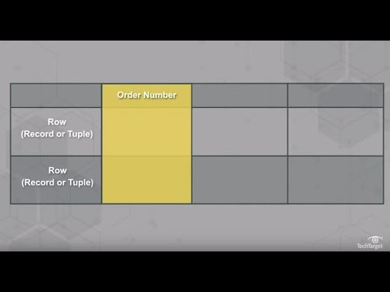
What is a relational database?

Slide 4
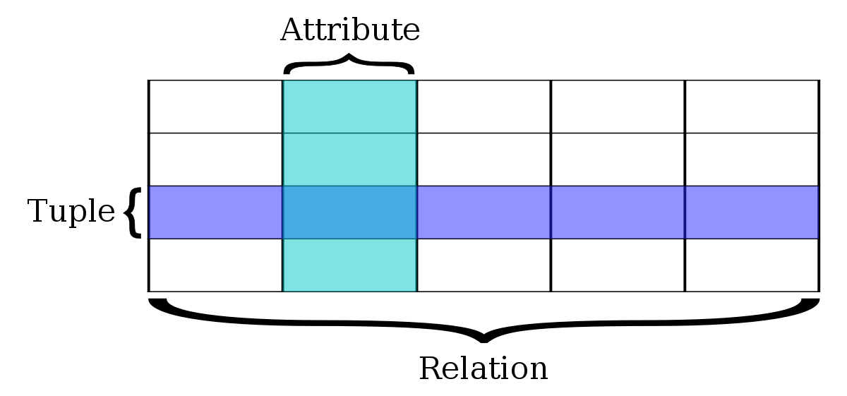
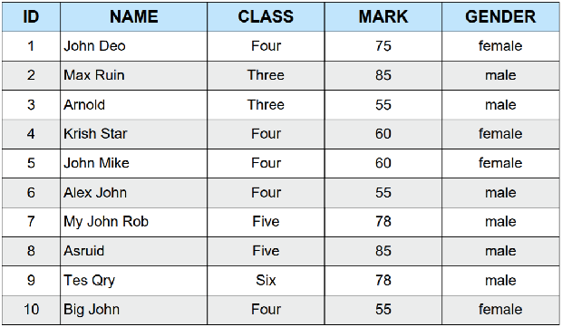
Relation
A relation refers to the whole table in a database. This table contains attributes.
For example: a typical business order entry database would include a table that describes a customer with columns for name, address, phone number and so forth.
Another table would describe an order, including information like the product, customer, date and sales price.
Source: https://www.techtarget.com/searchdatamanagement/definition/relational-database#:~:text=Each%20table%2C%20sometimes%20called%20a,categories%20defined%20by%20the%20columns.

Slide 5
Attribute
An attribute is a piece of data that describes an entity. For example, in a customer database, the attributes might be name, address, and phone number.
In the example below, the “Name” is the attribute and the “John Deo” is the entity.

Slide 6
Domain
The data type defined for a column in a database is called a database domain. This data type can either be a built-in type (such as an integer or a string) or a custom type that defines data constraints.

Slide 7
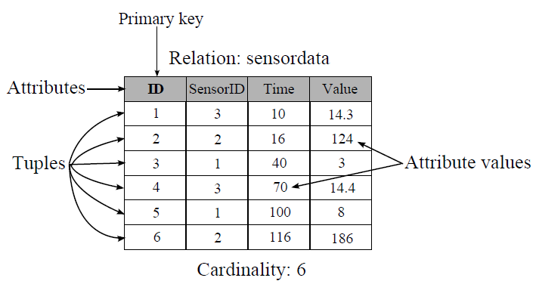
Tuple
A tuple is a single row in a database that contains a single record for such a relation.

